Slide 1
Golden Lake Hydroacoustic Survey Analysis Results

Slide 2
Overview
Three night-time hydroacoustic surveys conducted in 2009, 2010, 2022
Surveys consisted of parallel transects run in the main basin in 2009, 2010, and in both basins in 2022
Pelagic netting conducted concurrent with surveys in 2009 & 2022
Acoustic data processing conducted in Echoview 15 software
Acoustic data analysis conducted in R
Accompanying Word ReadMe file provides analysis background, procedures and glossary of terms (GoldenLakeHydroacousticDataAnalysisReadMe.docx)

Slide 3
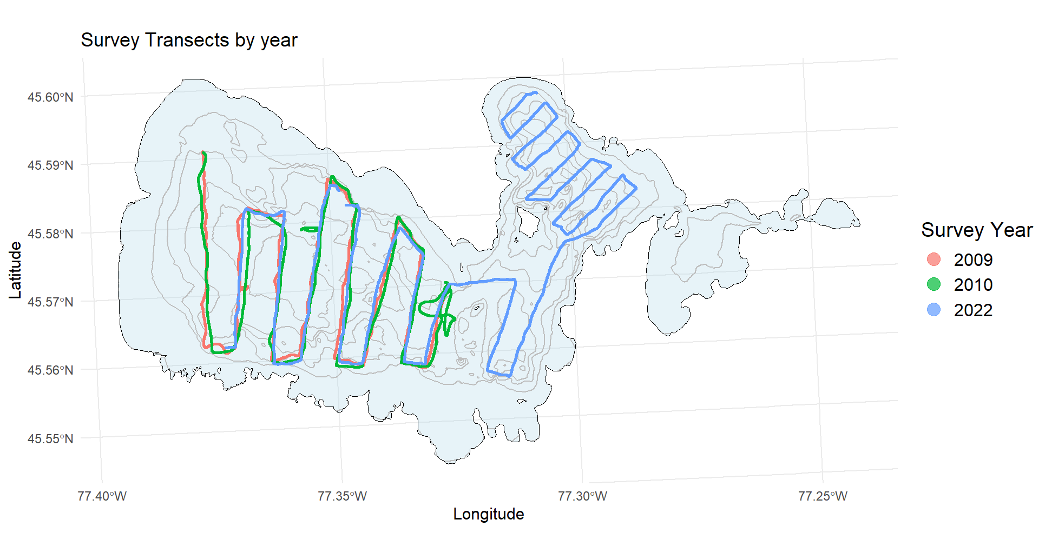

Slide 4
Details of hydroacoustic surveys conducted on Golden Lake
Year | Survey Date & Time | Frequencies Used | Equipment | Total Survey Distance (km) | Netting
2009 | July 29 – July 30 21:09 - 01:11 | 70 & 200 kHz | Simrad EK60 | 29.5 | - 2 nets @ 6-12m depth - 2 nets @ 12-18m depth
2010 | August 12 -July 13 20:31 –00:34 | 70 & 200 kHz | Simrad EK60 | 26.5
2022 | August 09 - July 10 21:02 –01:28 | 70 & 200 kHz | Simrad EK80 | 37.6 | - 2 nets @ 0-6m depth - 2 nets @ 6-12m depth - 2 nets @ 12-18m depth

Slide 5
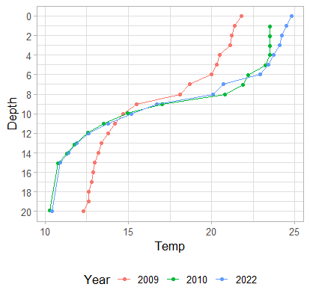
Temperature Profiles Golden Lake – mid-basin
Epilimnion Analysis Layer
Metalimnion Analysis Layer
Hypolimnion Analysis Layer

Slide 6
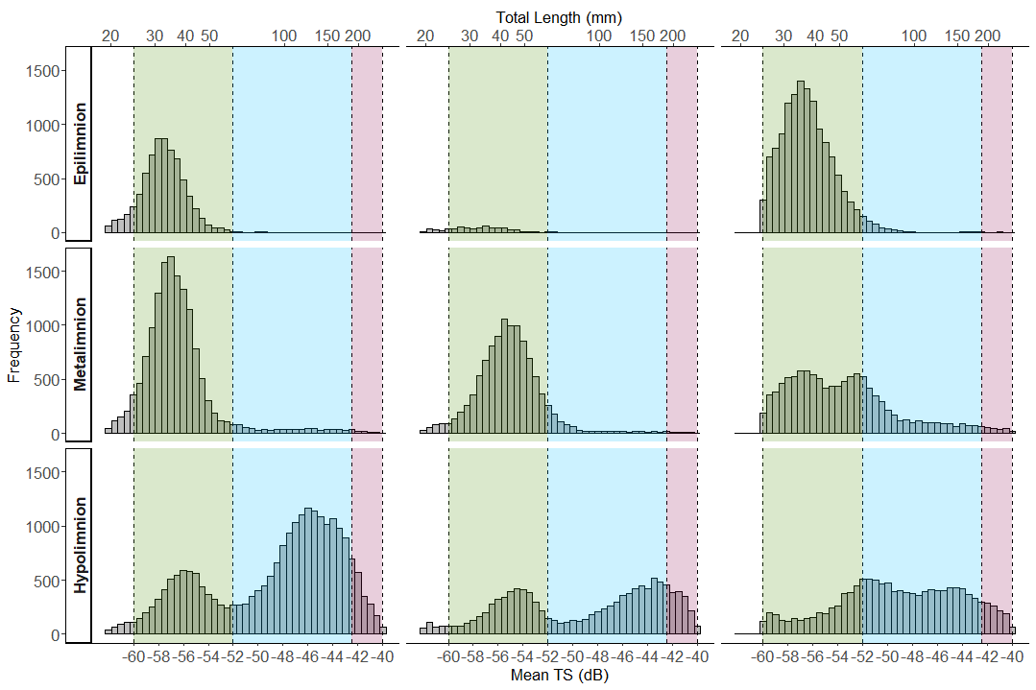
Distribution of Fish Track Target Strength Values and Analysis Size Classes
2009
2010
2022
Class 1
Class 2
Class 3
Class 1
Class 2
Class 3
Class 1
Class 2
Class 3

Slide 7
Analysis Size Class details
Size Class 1
Identified by the first mode in the previous slide of target strength distributions. Using the Rudstam, 2003 smelt specific equation to convert target strength to fish length this mode approximately equates to fish sized from 25mm to 60mm total length
This mode is most dominant in the upper and mid water column (epilimnion and metalimnion analysis zones)
Fish in this size class are smaller than the smallest fish sampled by the pelagic nets and species composition is therefore unknown. This size class is most likely comprised primarily of smelt given the vertical distribution in the water column. Similar separation of young-of-year smelt (YOY) from yearling-and-older (YAO) smelt has been observed and documented in other lakes (Stetter, 2006)

Slide 8
Analysis Size Class details
Size Class 2
This size class starts at the end of the first size class up to the Target Strength (TS) of the largest smelt recorded in netting, 186 mm (BsM – 2015)
This mode is generally absent in the upper layers of the water column and dominant in the cold water of the hypolimnion.
Within this size range only rainbow smelt were captured in pelagic netting (last slide of this presentation). While netting wasn’t exhaustive this does suggest that this size class is dominated by rainbow smelt.
The lower end of this size class likely includes some portion of the YOY population, especially in the 2010 and 2022 surveys as they were conducted two weeks later than the 2009 survey.

Slide 9
Analysis Size Class details
Size Class 3
This size class captures the tail in the second mode of the TS distribution that extends beyond the upper limit of size class 2 to a TS converted length of ~250mm
This mode is only significantly present in colder, hypolimnetic waters.
The upper length limit of this size class, based on the TS regression equation from Rudstam 2003, is 250mm. Individual fish display large variation in TS however so while the largest observed size of rainbow smelt in Golden Lake from netting is ~190mm, this 250mm cutoff likely represents a realistic threshold including the largest smelt in the lake.
Netting results suggest that this size class is also likely dominated by rainbow smelt.
For the purposes of estimating Yearling and Older (YAO) fish abundance, the estimates of size classes 1 and 2 can be combined.

Slide 10
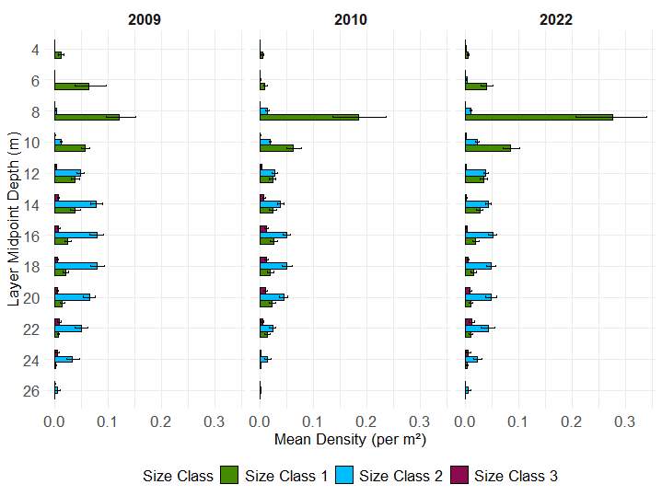
Mean Fish Density by Depth Layer (whiskers represent bootstrapped 95% Confidence Intervals)
Class 1 = young of year fish (~25-62 mm TLEN)
Class 2 = yearling and older fish (~62-186mm TLEN)
Class 3 = yearling and older fish (~186-250 TLEN)

Slide 11
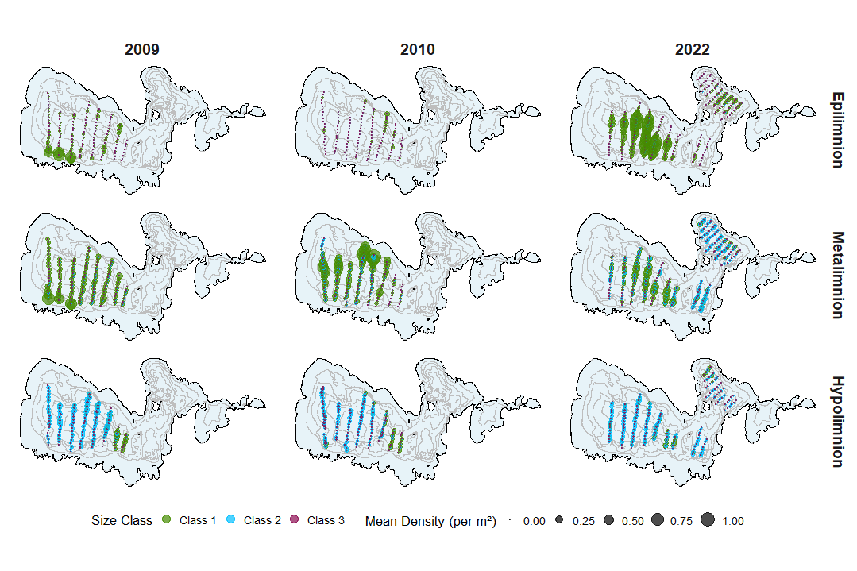
Spatial Distribution of Fish Density by Size Class (#/m²) and Analysis Layer
Class 1 = young of year fish (~25-62 mm TLEN)
Class 2 = yearling and older fish (~62-186mm TLEN)
Class 3 = yearling and older fish (~186-250 TLEN)

Slide 12
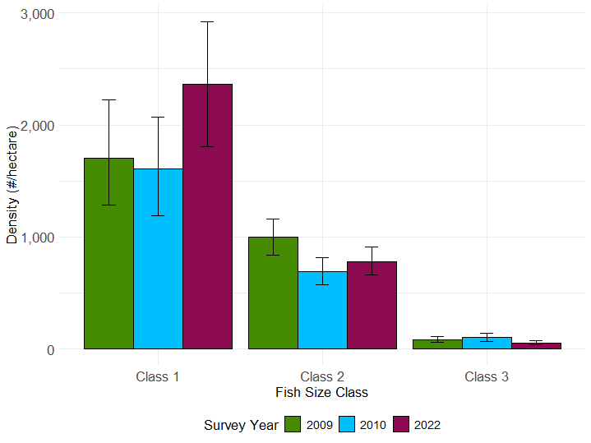
Lakewide Mean Fish Density Estimate (#/hectare) by Size Class (whiskers represent bootstrapped 95% Confidence Intervals)
Class 1 = young of year fish (~25-62 mm TLEN)
Class 2 = yearling and older fish (~62-186mm TLEN)
Class 3 = yearling and older fish (~186-250 TLEN)

Slide 13
Lakewide estimated total number of fish by size class (numbers in brackets represent bootstrapped 95% confidence intervals)
Year | Size Class 1 (25-62mm) - YOY | Size Class 2 (62-186mm) - YAO up to max observed smelt TLEN | Size Class 3 (186-250mm)
2009 | 6,048,580 (4,553,414 - 7,900,760) | 3,543,250 (2,977,889 - 4,133,146) | 291,841 (206,755 - 386,601)
2010 | 5,701,539 (4,237,083 - 7,341,272) | 2,449,217 (2,023,654 - 2,894,860) | 364,836 (241,465 - 507,460)
2022 | 8,396,482 (6,427,130 - 10,378,958) | 2,776,680 (2,339,955 - 3,235,754) | 196,196 (35,582 -268,120)
Estimated number of fish per hectare by size class (numbers in brackets represent bootstrapped 95% confidence intervals)
Year | Size Class 1 (25-62mm) - YOY | Size Class 2 (62-186mm) - YAO up to max observed smelt TLEN | Size Class 3 (186-250mm)
2009 | 1,703 (1,282 - 2,224) | 998 ( 838 - 1,164) | 82 ( 58 - 109)
2010 | 1,605 (1,193 - 2,067) | 690 ( 570 - 815) | 103 ( 68 - 143)
2022 | 2,364 (1,809 - 2,922) | 782 ( 659 - 911) | 55 ( 38 - 75)
YOY = Young-of-Year, based on distribution in water column presumed to be primarily rainbow smelt
YAO = Yearling-and-Older, netting results suggest composition is primarily rainbow smelt
TLEN = Total Length of fish from snout to tip of compressed tail

Slide 14
Results Summary
The magnitude of lakewide smelt abundance estimates are consistent between years with YOY estimates ranging from ~6 million fish in 2009 & 2010 to slightly more than ~8 million fish in 2022
Estimates of YAO abundance were also similar between years with combined abundance estimates from size class 2 & 3 ranging from ~3 million to ~4 million fish
These lakewide estimates translate to average densities of ~1,800 fish/hectare for the YOY size class, and ~900 fish per hectare for the combined YAO size classes
The vertical distribution of YOY sized targets in these surveys is consistent with observations from smelt studies in other lakes, with YOY smelt generally preferring lower epilimnion and metalimnetic waters (Parker-Stetter, 2006). Our assumption, based on these studies, is that Size Class 1 is likely composed primarily of rainbow smelt.
Netting results suggest that YAO fish detected during these surveys are primarily rainbow smelt. No other species within the size range analyzed was caught in the pelagic nets.
There are a limited number of studies that provide comparison points for lakewide estimates of smelt abundance and density in inland lakes. The several that do however, either in North American lakes with rainbow smelt, or smelt analogues in European Lakes have reported densities within range of, or far exceeding these observed in Golden Lake. (Horpilla 1996, Keskinen 2012, Gaeta 2015, Nyberg 2019)

Slide 15
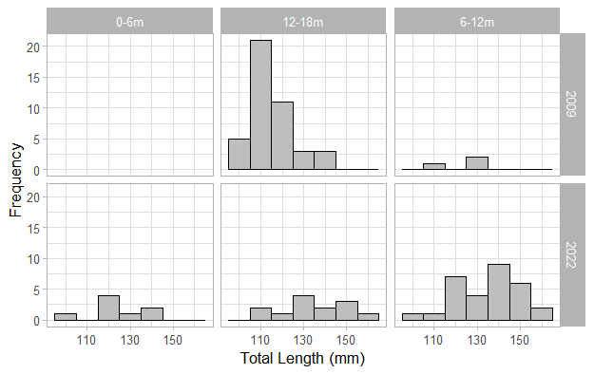
Rainbow Smelt Catch and Size Distribution from Pelagic Netting – Golden Lake
Year | 0-6m Depth |  | 6-12m Depth |  | 12-18m Depth
 | N Caught/ CUE (#/net) | Size range(mm) | N Caught/ CUE (#/net) | Size range(mm) | N Caught/ CUE (#/net) | Size range(mm)
2009 | NA | NA | 3/1.5 | 109-130 | 44/22 | 104-140
2022 | 8/4.0 | 95-141 | 30/15 | 105-160 | 13/6.6 | 113-160
* One large lake whitefish ~ 600 mm total length was captured in 2009 in the 12-18m depth stratum

Slide 16
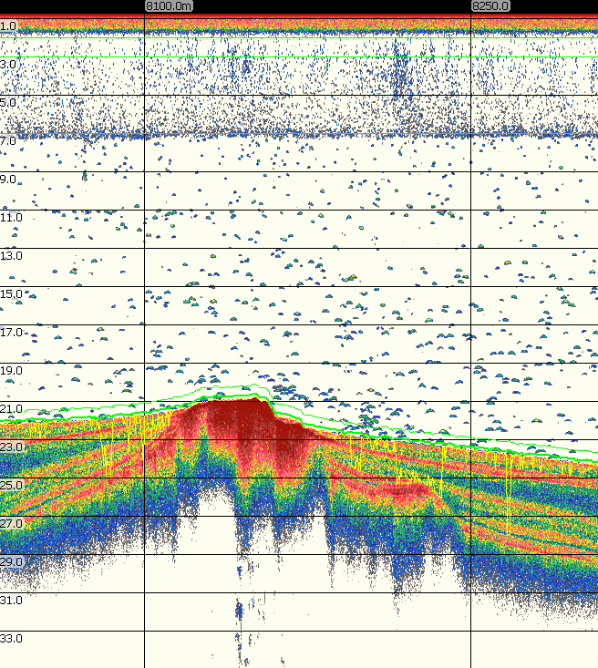
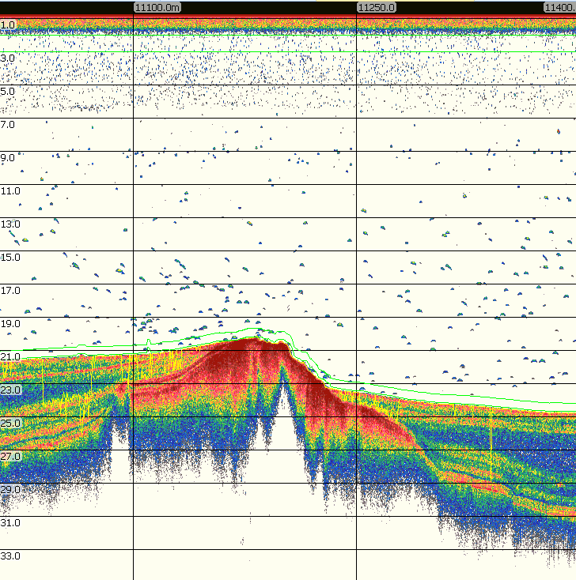
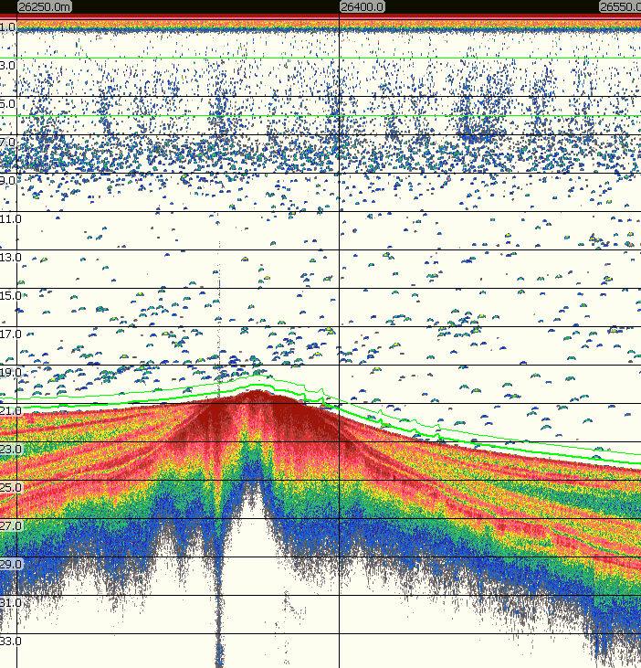
Sample section of Sv Echogram from all three years (no TS threshold applied, -60 dB Sv threshold)
2009
2010
2022

Slide 17
Horpila J. K. Nyberg, H. Peltonen & T. Turunen, 1996 Effects of five years of intensive trawling on a previously unexploited smelt stock. Journal of Fish Biology 49, pp 329-340
Parker-Stetter S. L., L.G. Rudstam, J.L. Stritzel Thomson, D.L. Parrish, 2006. Hydroacoustic separation of rainbow smelt (Osmerus mordax) age groups in Lake Champlain. Fisheries Research 82, pp. 176-185
Rudstam, L. G., S.L. Parker, D.W. Einhouse, L.D. Witzel, D.M. Warner, J.L. Stritzel, D.L. Parrish, P.J. Sullivan. 2003. Application of in situ target-strength estimations in lakes: examples from rainbow-smelt surveys in Lakes Erie and Champlain. ICES Journal of Marine Science, 60 pp 500-507.
Keskinen T., J. Lilja, P. Hogmander, J.A. Holmes, J. Karjalainen, T. Marjomaki. 2012. Collapse and recovery of the European smelt (Osmerus eperlanus) population in a small boreal lake – an early warning of the consequences of climate change. Boreal Environment Research 17. pp 398-410
Gaeta, J.W., T.R. Hrabik, G.G. Sass, B.M. Roth, S.J. Gilbert, M.J. Vander Zanden. 2015. A whole-lake experiment to control invasive rainbow smelt (Actinoperygii, Osmeridae) via overharvest and a food web manipulation. Hydrobiologia, 746. pp. 433-444
Nyberg P. E. Bergstrand, E. Degerman, O. Enderlein , 2001. Recruitment of pelagic fish in an unstable climate: studies in Sweden’s four largest lakes. AMBIO A Journal of the Human Environment 30(8). pp 559-64

